Slide 1
IST659 Data Admin Concepts and Database Management
Forms and Reports
Week 10

Slide 2
Acknowledgements and caveat
These course materials draw liberally, with permission, from the following sources:
IST659 classes taught by Prof. Bei Yu
IST659 classes taught by Prof. Susan Dischiave
IST 659 classes taught by Prof. Yun Huang
Instructor resources provided by our text book ”Modern Database Management”
Caveat (beware): At best, PowerPoint slides are only a pale imitation of the entirety of a class meeting. In IST659 in particular, the lectures will cover topics beyond what appears in these slides. Don’t rely on them as a substitute for attending class.

Slide 3
Interface design
A simple example in Access
Create an employee table with columns EID, EFName, ELName
Create a project table with columns PID, Pname, PManagerID
Create a one-to-many relationship between employee and project
One employee can manage zero or more projects
One project is managed by one and only one employee

Slide 4
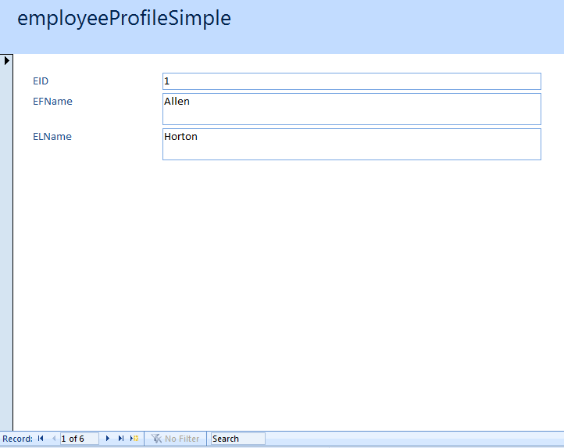
Input forms
A simplest form created directly from the employee table
Input and navigate records

Slide 5
Exercise
Create a project profile form
Navigate records through the form
Input one new record through the form

Slide 6
Form with subform
Because there is a one-to-many relationship between the employee table and the project table, a project subform can be embedded into the employee table to list the projects managed by this employee

Slide 7
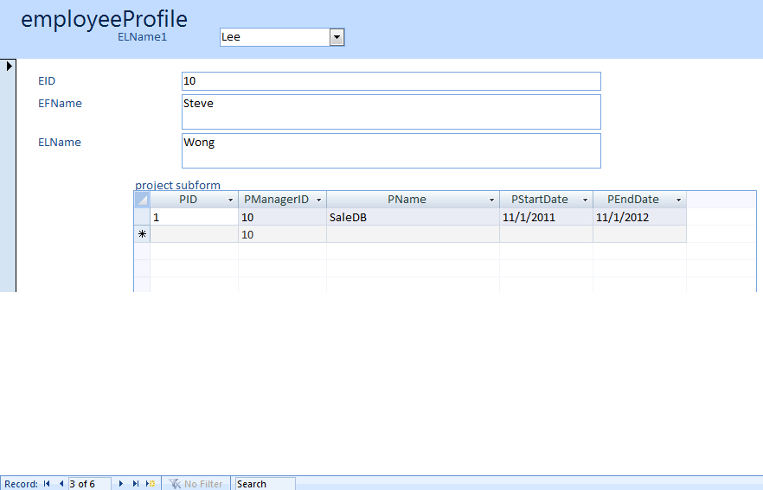
Form with subform

Slide 8
Exercise
Create a new table “department” with columns DID and DName
Add a few values “sales”, “marketing”, and “HumanResource”
Add a column “DID” to employee table, assign DID values to the employees
Create one-to-many relationship between department and employee
Create a simple form for department
Add an employee subform for department

Slide 9
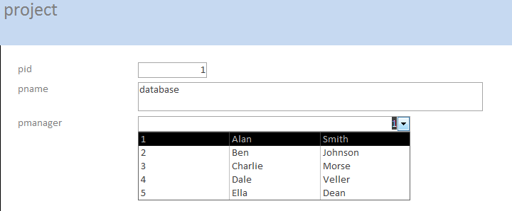
Combo box

Slide 10
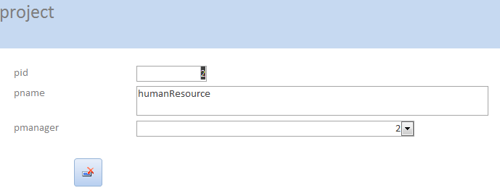
Buttons

Slide 11
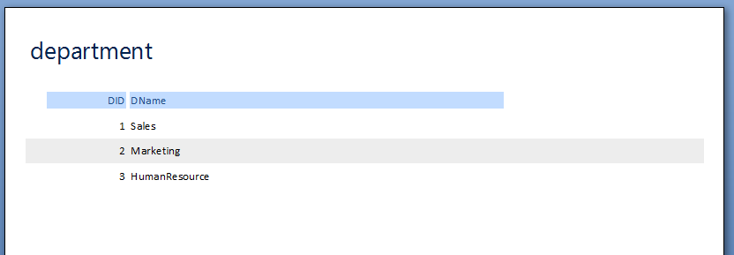
Reports
Simple report from one table

Slide 12
Exercise
Generate employee report

Slide 13
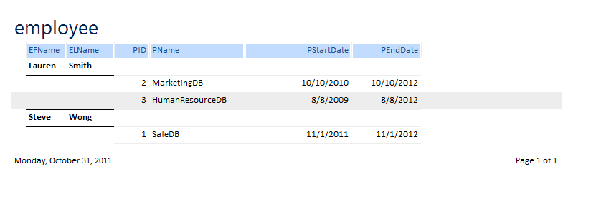
Generate report from multi-table join
Join the employee and project table
Problem: missing employees who do not manage projects
Solution: change the query from inner join to left join

Slide 14
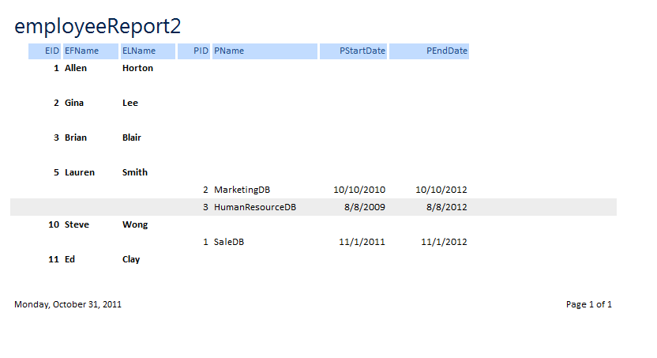
Generate report from left join

Slide 15
Generate report from query
Use query wizard to create a query
Create report from query

Slide 16
Exercise
Create a query to find all departments and their employees
Create a report by using the query

Slide 17
Exercise
Create a query to find the number of employees in each department
Create a report of the departments and the number of employees in each department by using the query

Slide 18
Generate report by using view
Create a view in SQL Server
Using ODBC to connect Access and SQL Server
Link the view to Access
Generate report using the view (treated as a table in Access)

Slide 19


4 basic principles:
Contrast
Repetition
Alignment
Proximity
Notes:
http://2012books.lardbucket.org/books/designing-business-information-systems-apps-websites-and-more/s07-01-c-r-a-p-principles-of-graphic-.html
http://www.myinkblog.com/4-principles-of-good-design-for-websites/

Slide 20
Project implementation report
Guideline released
Project implementation report due before the 1st week of project demo
Project demo
Final improvement after demo
Final report should include updates/changes based on feedback received from the demo

Slide 21
Turnitin
Must use Turnitin to submit the final report
Penalty if >=25% copy material according to the originality report
You can check your drafts with Turnitin by using the “turnitin at the library”
http://researchguides.library.syr.edu/turnitin
May take 24 hours to resubmit and get the originality report

